Slide 1
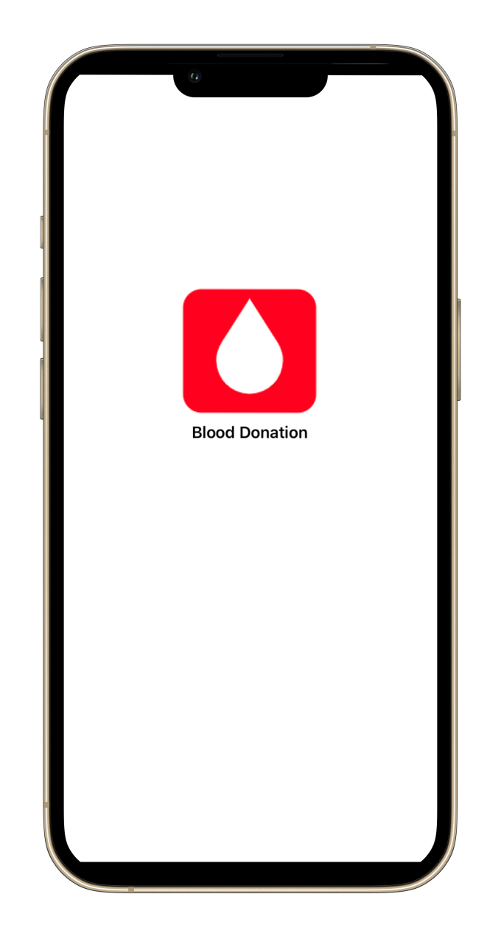
Blood Donation

Slide 2
Introduction
Blood Donation
A mobile Application that helps people who’s in need for blood to reach donors.

Slide 3
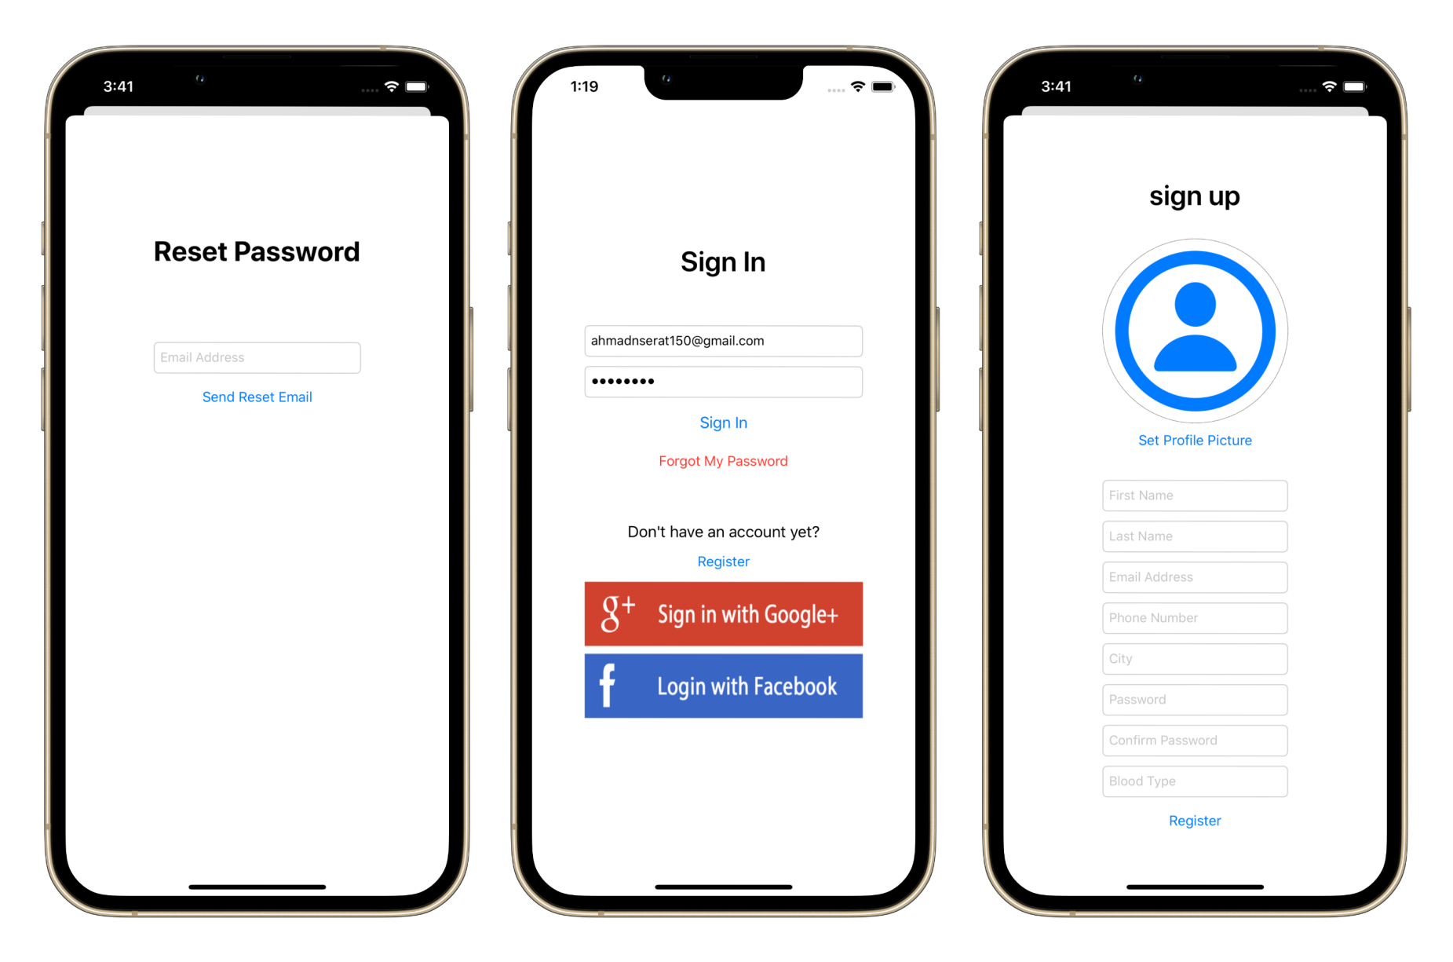
Login and registration

Slide 4
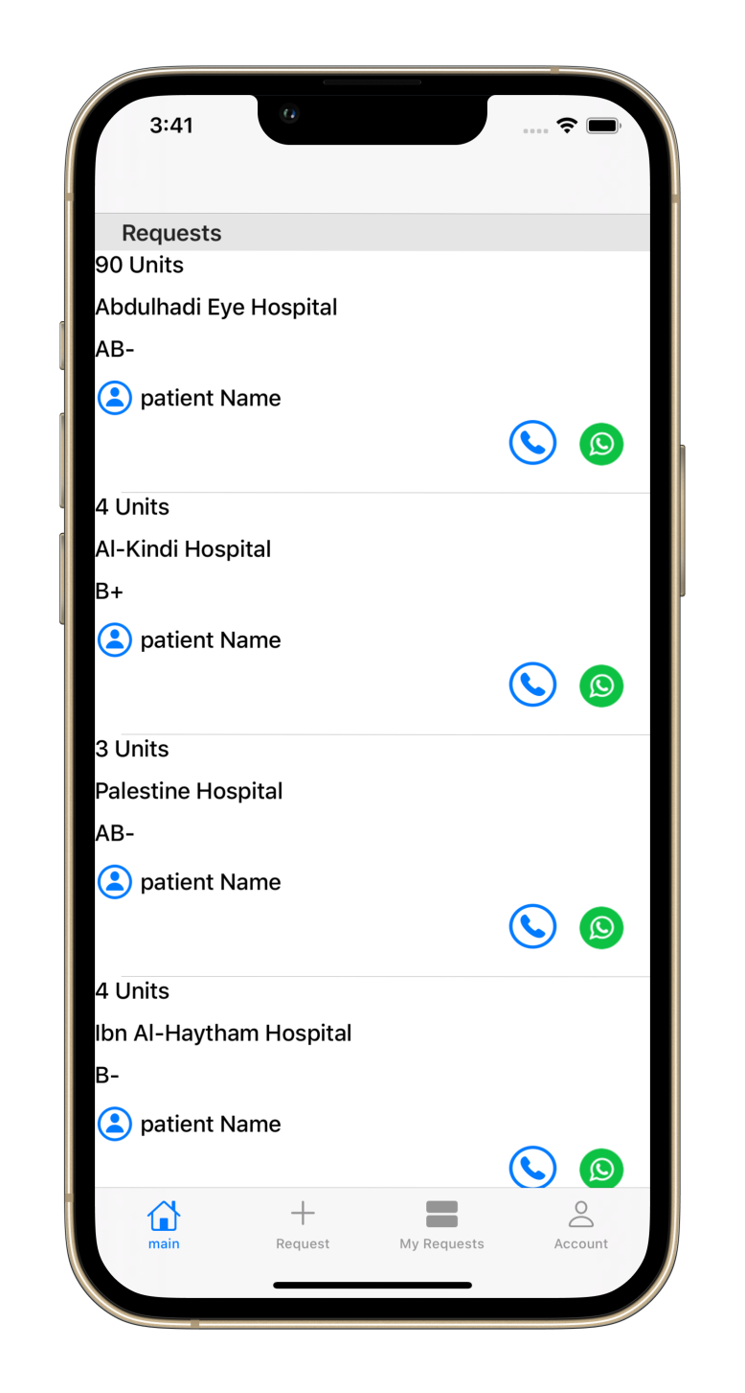
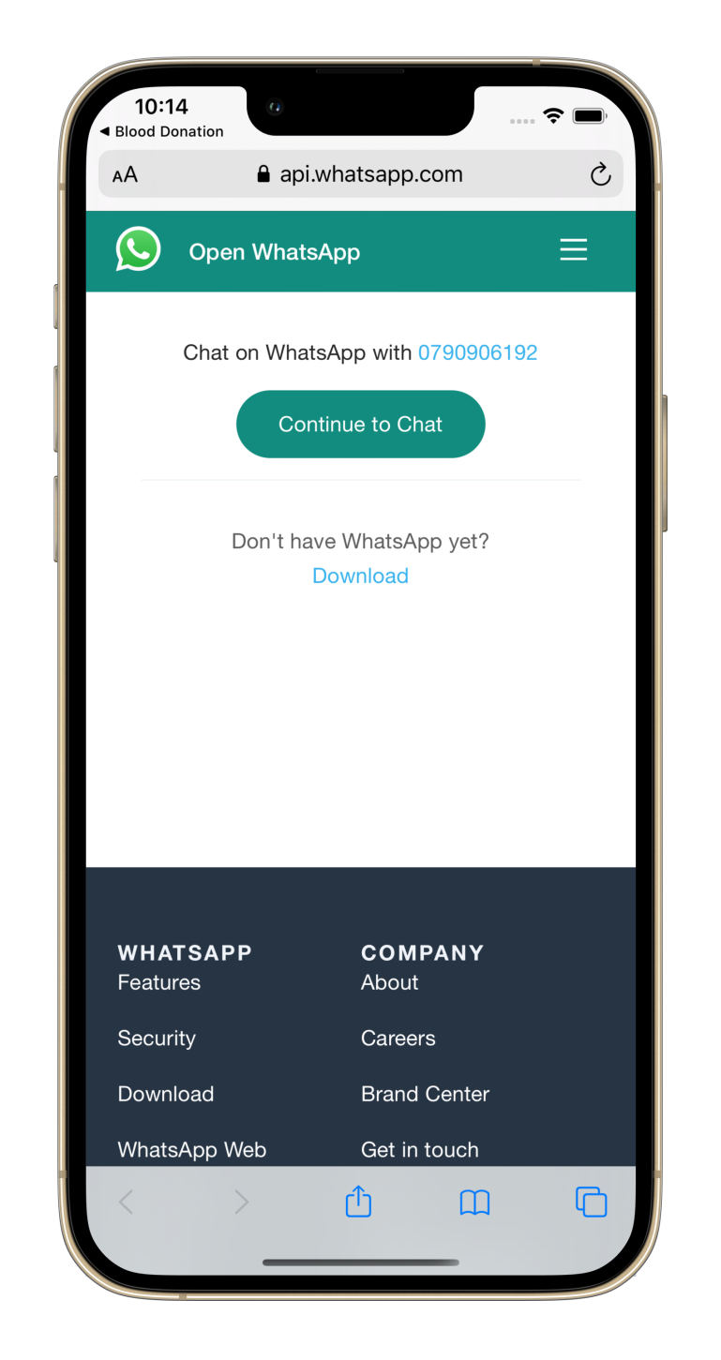
Requests page

Slide 5
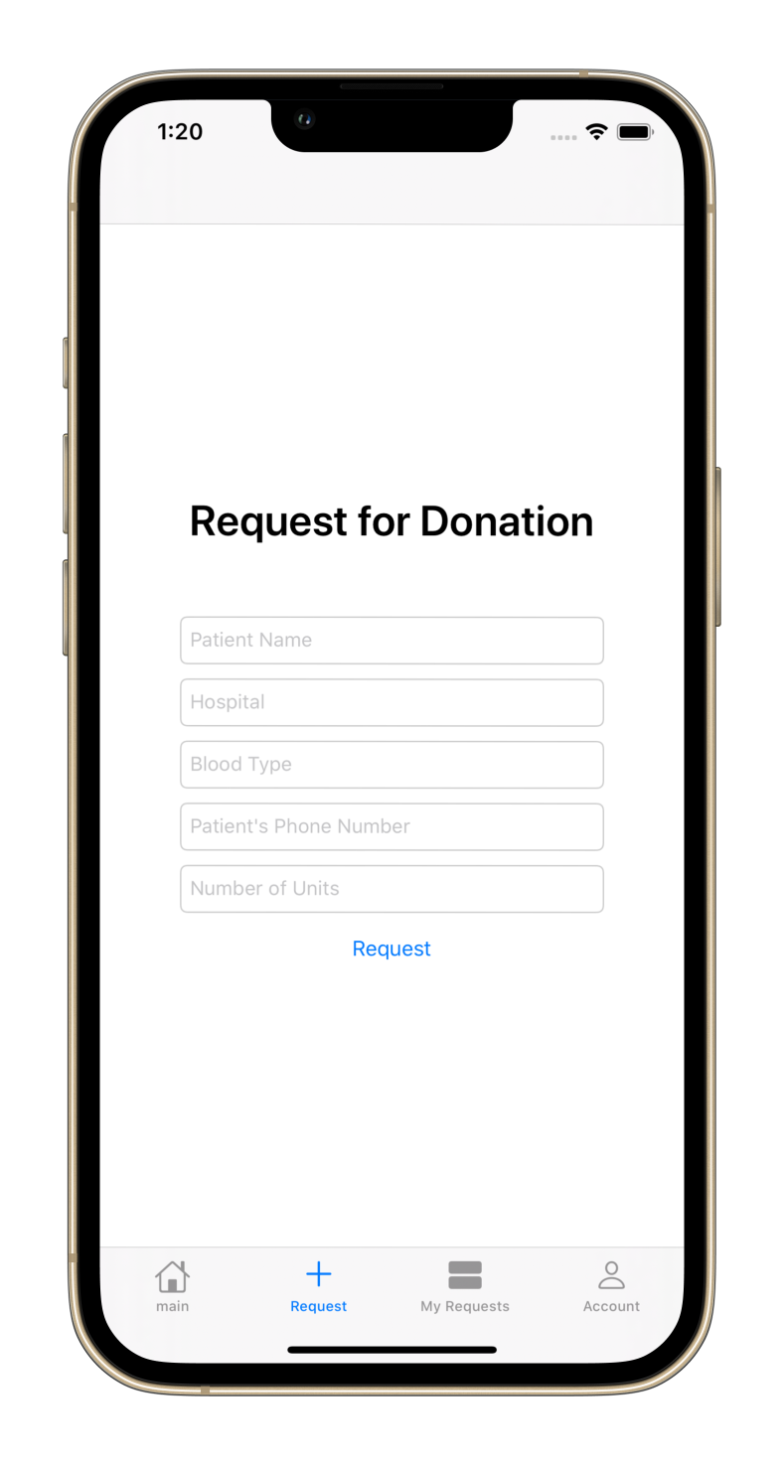
Request for donation

Slide 6
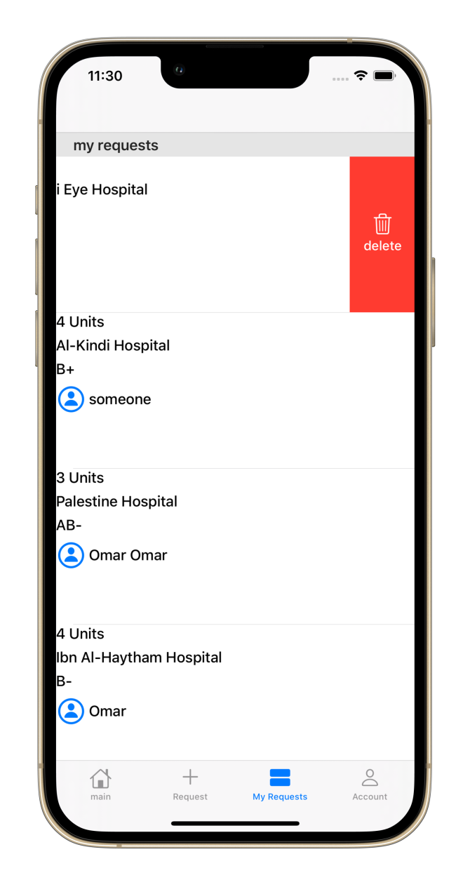
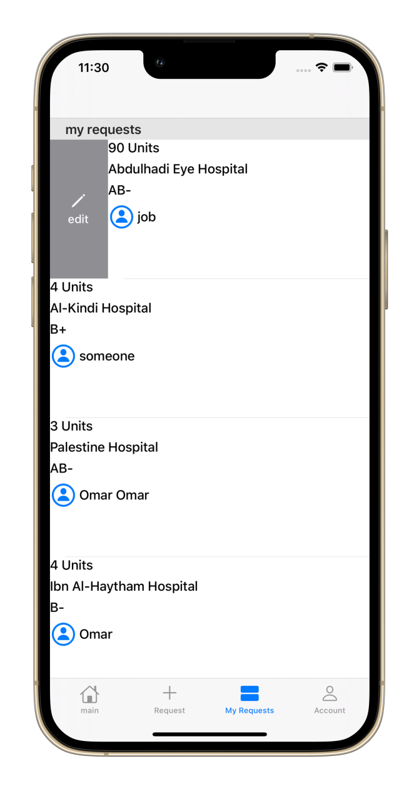
Manage requests

Slide 7
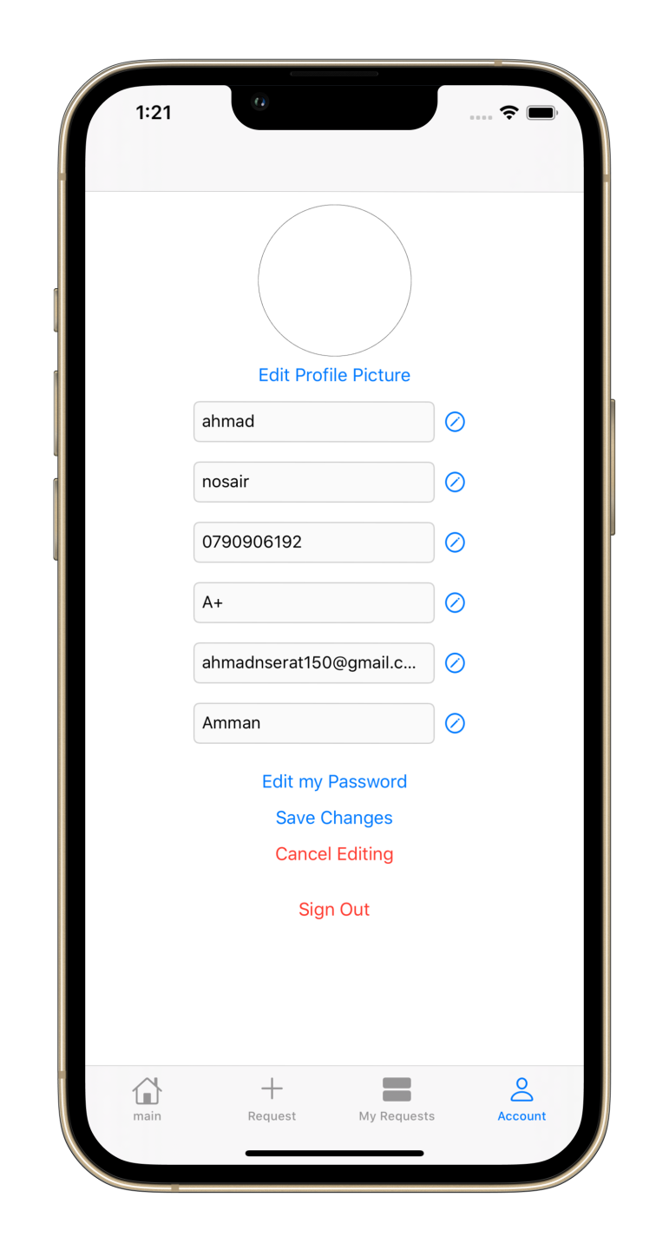
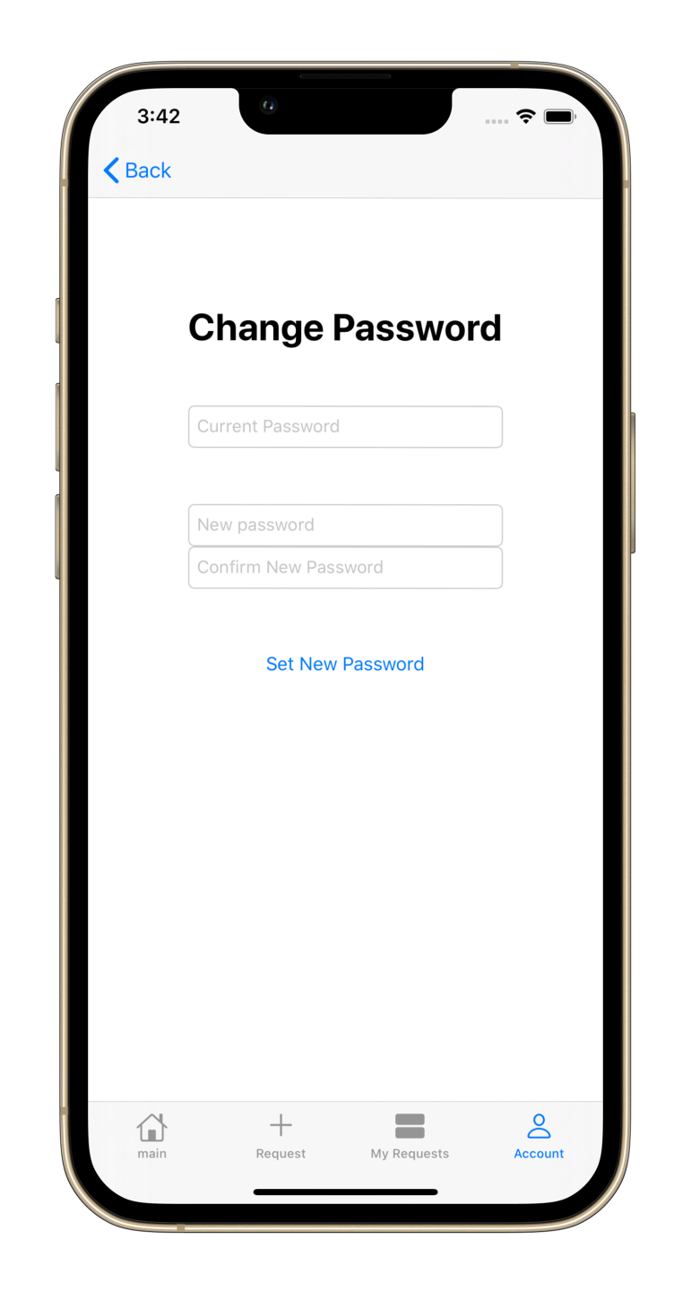
Account management

Slide 8


Tools & technologies

Slide 9
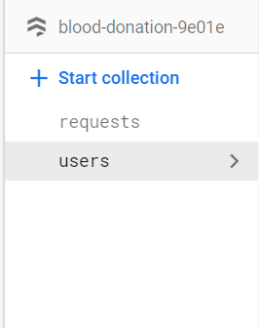
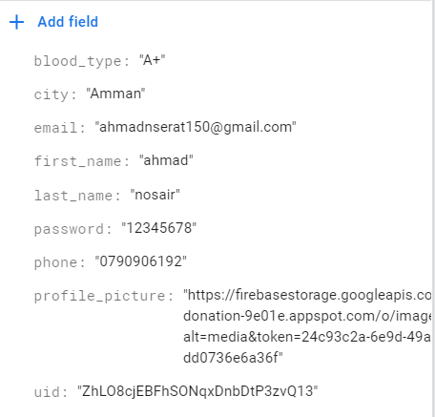
firestore
Used to Store Users and Requests information in collections and retrieving or updating them when needed.

Slide 10
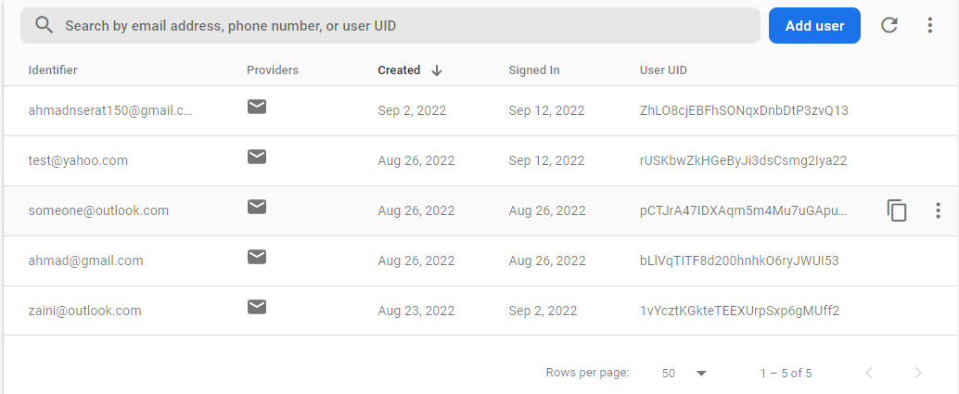
Firebase authentication
Used to Register new Users and for Authorization on Sign in and for Resetting forgotten Passwords .

Slide 11
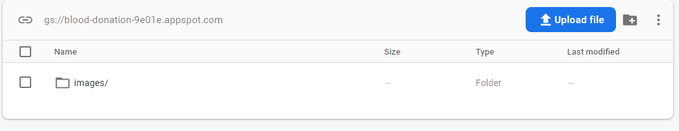
Firebase storage
Used for storing Profile pictures of the users “the URL of the Picture is saved in the users collection in Firestore”.

Slide 12
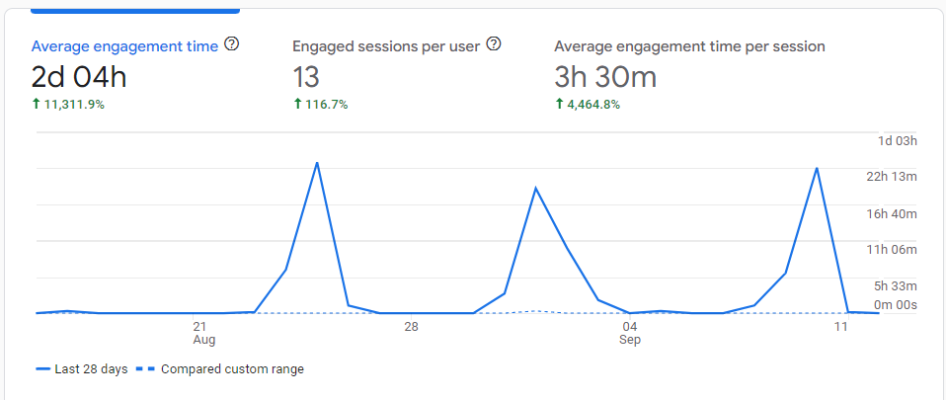
Firebase analytics
Used for collecting data and analyzing users activity on the application.

Slide 13
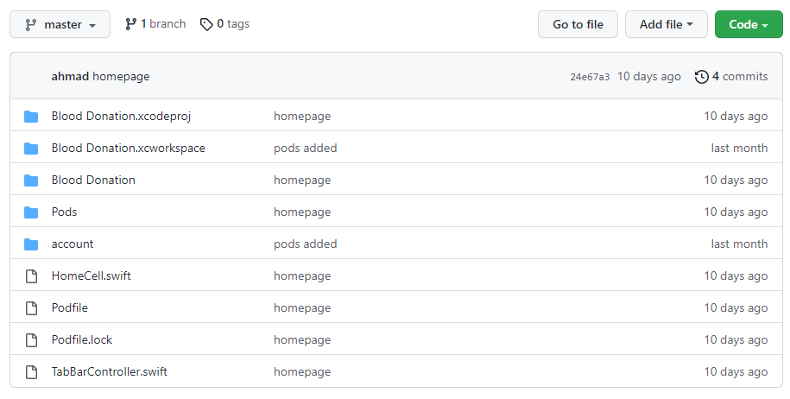
github
Used for sharing the source code and keeping a backup of the project.

Slide 14
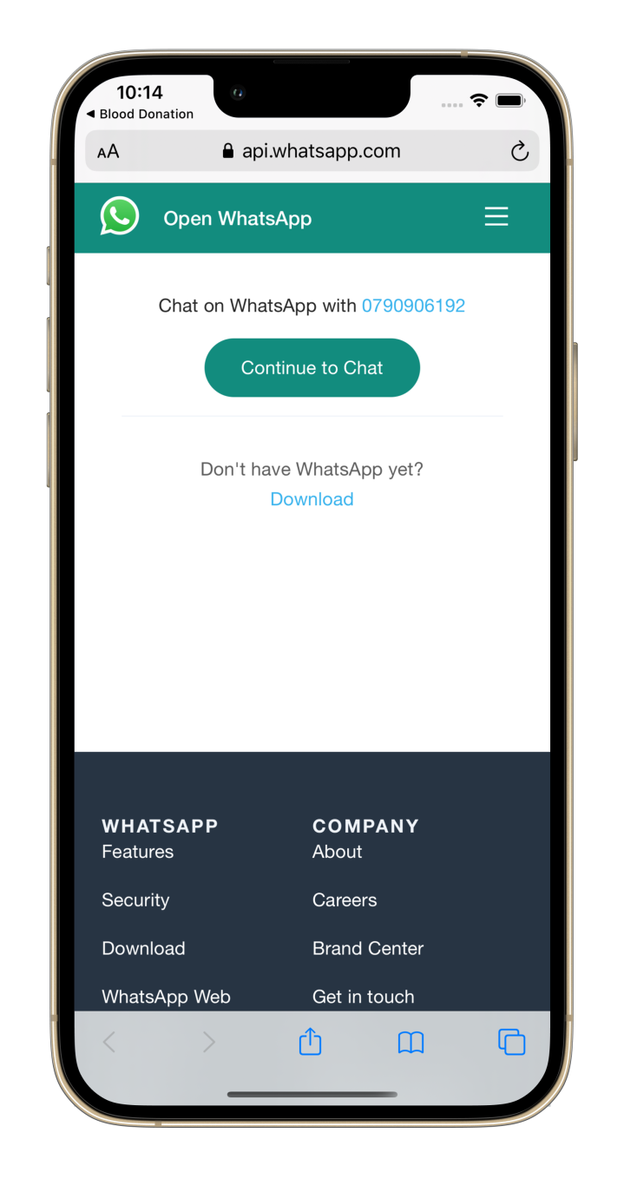
Whatsapp api
Used to contact with the request applicant.

Slide 15
Q&A

